Slide 1
Mom2B: a study of perinatal mental health via smartphone application and machine learning methods
Ayesha Mae Bilal
Dept. of neuroscience
Womher research school
Uppsala university

Slide 2
Overview:
10% to 20% of all mothers globally
Health consequences:
Fetal growth retardation, preterm delivery, low birth weight, and birth complications such as preeclampsia, placental abnormalities, and spontaneous abortion.^{3, 4}
Impact on the mother-infant bond, maternal caregiving ability and infant development⁵
Suicidality⁶
Perinatal depression

Slide 3
Inflammation
Lower income and education level
Lack of social support
Maternal Anxiety
Lack of exercise
Adverse childhood experiences
Life stressors
Depression/Anxiety history
Low resilience
Smoking
Variation on chromosome 1q21.3–q32.1
Domestic violence
Single status
Overweightness
Dagher et al. (2021)

Slide 4
A GAP BETWEEN
~69% of cases go undetected⁸
Early detection often difficult in clinical settings⁹
difficulty identifying depression due to overlap of cardinal symptoms of depression and normal experiences of pregnancy
stigma/shame from failure to live up to expectations of motherhood
cultural factors
inconsistent screening practices
recall biases during screening
need and treatment

Slide 5
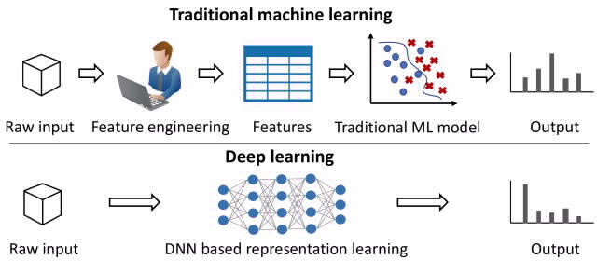

Slide 6
What has previously been done?
Biology, Affect, Stress, Imaging and Cognition (BASIC) study
population-based prospective cohort study in Uppsala, Sweden (2009-2018)
Data collected from pregnant/postpartum women included:
background, medical history and pregnancy-related variables
further psychometric questionnaires, available at discharge from the delivery ward
Aim: Predict women at risk for depressive symptoms at 6 weeks postpartum using EPDS ($≥$12 score) by use of traditional machine learning methods.
Andersson, S., Bathula, D. R., Iliadis, S. I., Walter, M., & Skalkidou, A. (2021). Predicting women with depressive symptoms postpartum with machine learning methods. Scientific reports, 11(1), 1-15.

Slide 7
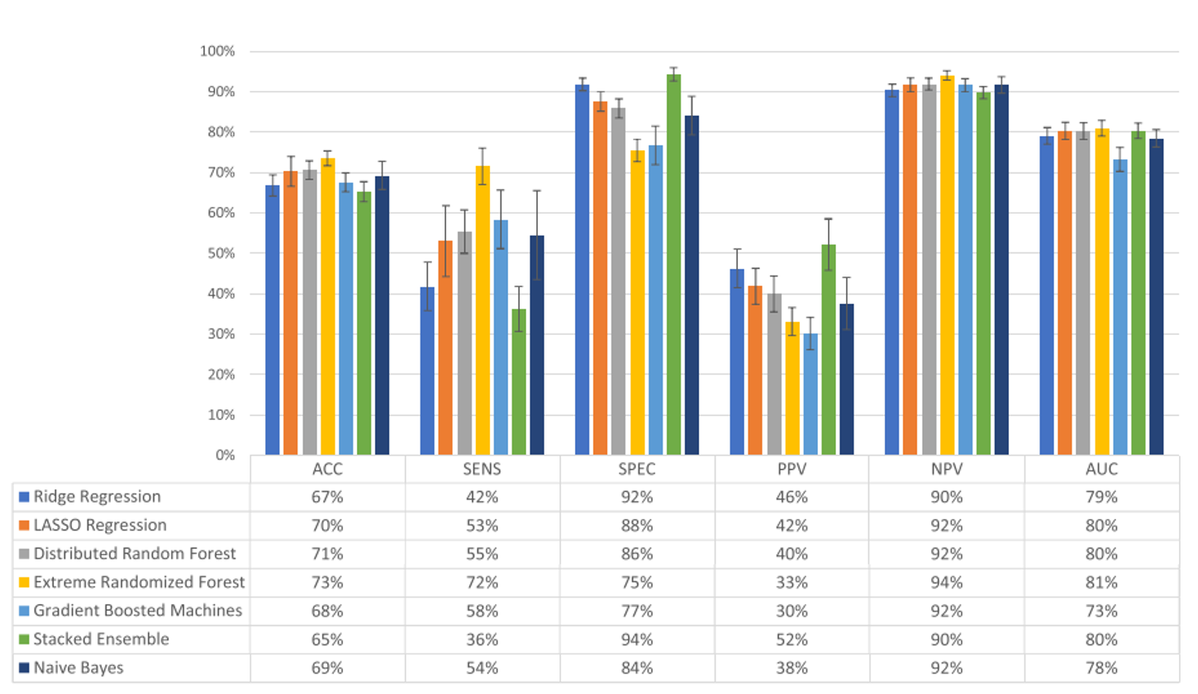
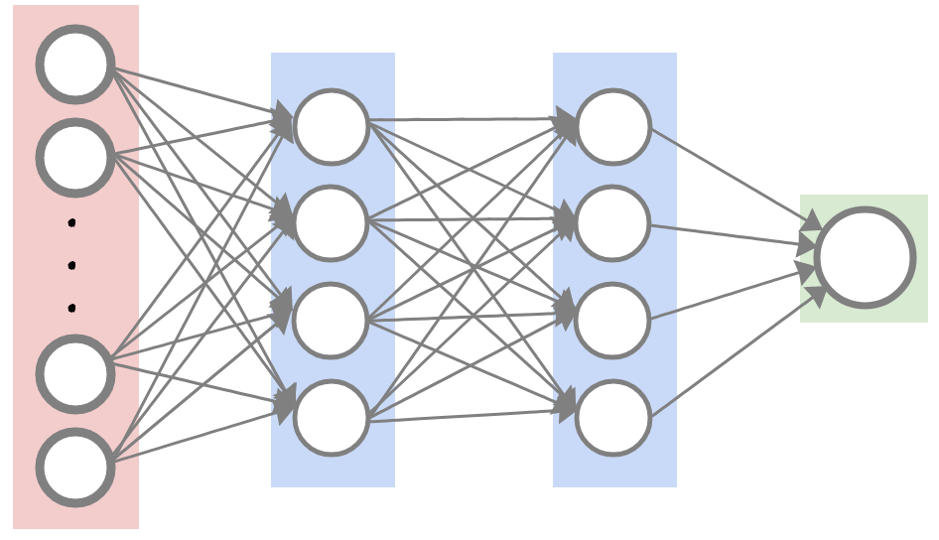
What has previously been done?
Anxiety during pregnancy
Depression during pregnancy
Output layer
GWAS
SNPs
Hidden layer 1
Hidden layer 2
Input layer

Slide 8
What has previously been done?
Traditional Machine Learning
Extremely randomized trees method
Accuracy 73%, sensitivity 72%, specificity 75%, positive predictive value 33%, negative predictive value 94%, area under the curve 81%
Variable importance: depression and/or anxiety during pregnancy, resilience, sense of coherence and personality.
Deep Learning
No significant improvement in performance was observed with the application of Deep Neural Networks in comparison to the traditional machine learning algorithms

Slide 9
Mom2B: predicting perinatal depression using digital phenotyping and advanced ML and DL

Slide 10
DIGITAL PHENOTYPING
Using digital devices (eg. smartphones) to capture moment-by-moment, objective data regarding the user’s experiences and functions in the real world.
Active Data
Passive data
What is it? How do we use it?

Slide 11
GPS
Motion Activity
Accelerometer
Power State
Facebook Usage
Connectivity and Internet Usage

Slide 12
Digital Phenotyping: why use it?
Strengths
Large-scale data
Objective
Real world context
Temporally sensitive
Less susceptible to recall bias
Can be integrated easily into healthcare practice
Limitations
greater attrition rates with active data

Slide 13
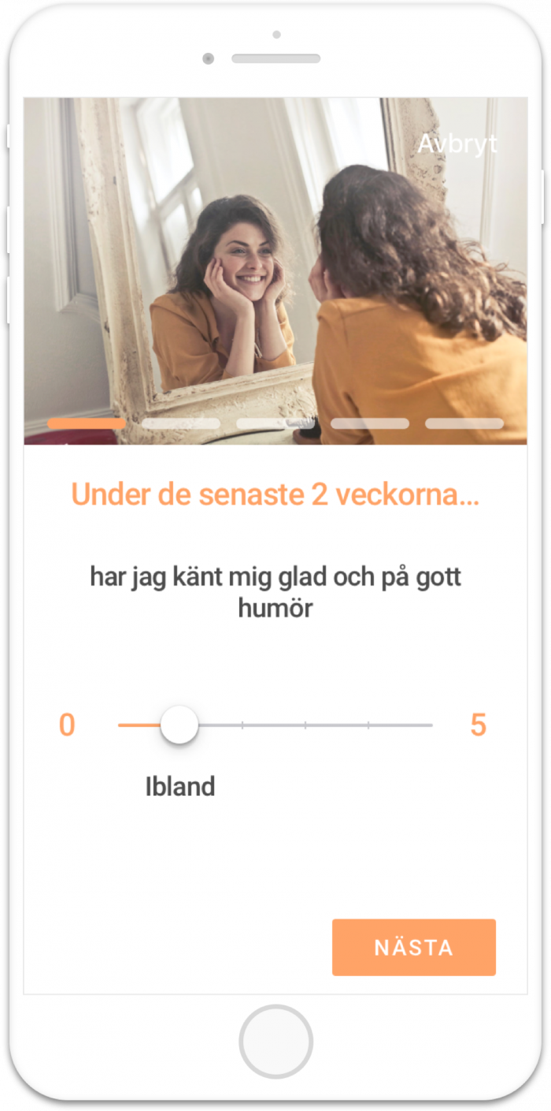
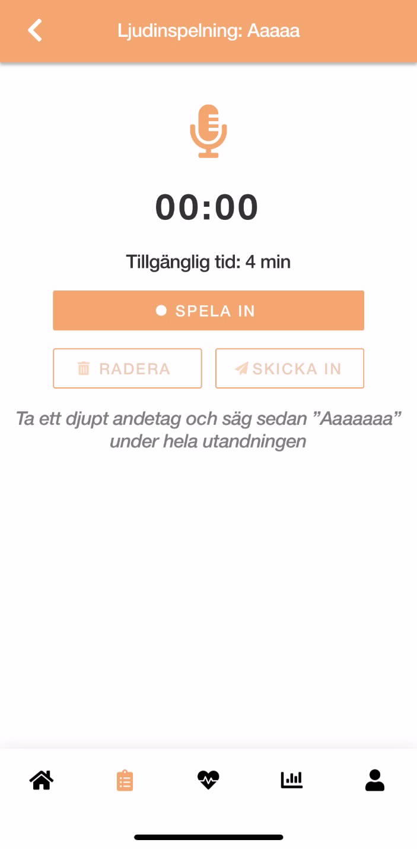
Self-report measures incl. EPDS
Voice recordings
Passive data
Swedish National health and pregnancy register data

Slide 14
Assessing Advanced ML/DL methods to predict risk of PND
Aims
Assess advanced machine learning/deep learning algorithms for predicting PND in the:
3rd trimester using data from 1st and 2nd trimester
Early postpartum period using data from pregnancy-birth
Late postpartum period using data from pregnancy-2 months pp
Output measure
EPDS

Slide 15
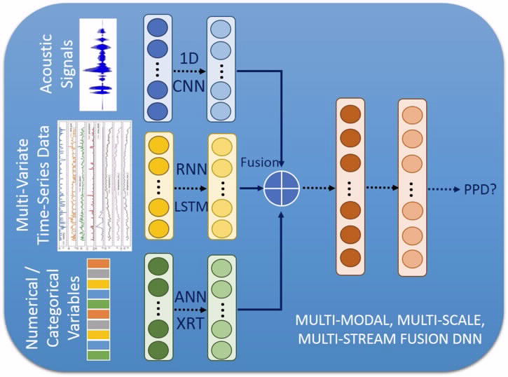
Assessing Advanced ML/DL methods to predict risk of PND

Slide 16
Mom2B cohort
Cohort at the moment
4100 women (Oct 2021)
Average 31 years, 90% Swedish, 80% higher education.
Eligibility criteria
Swedish speaking women, 18+, owning smartphone
Pregnant – 3 months postpartum

Slide 17
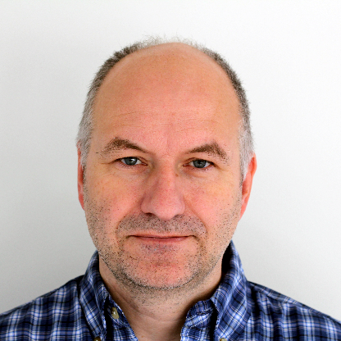
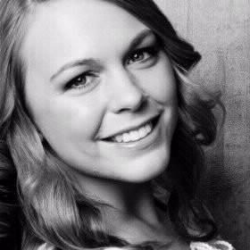
Mom2B Team at Uppsala University
Alkistis Skalkidou
Dept. Women’s and
Children’s Health, UU
Fotios Papadopoulos
Dept. Neuroscience, UU
Emma Fransson
Dept. Women’s and
Children’s Health, UU
Ulf Elofsson
Dept. Neuroscience, UU
Ayesha Mae Bilal
Dept. Neuroscience, UU
Emma Bränn
Dept. Women’s and
Children’s Health, UU
Allison Eriksson
Dept. Women’s and
Children’s Health, UU
Mengyu Zhong
Dept. Information Technology,
UU

Slide 18
Thank you!

