Slide 1

Creating and sustaining alliances to promote perinatal mental health
Vision, Persistence, Determination, Solidarity and Solutions
Dr Alain Gregoire
Perinatal psychiatrist
President, UK Maternal Mental Health Alliance
Chair, Global Alliance for Maternal Mental Health

Slide 2
Steps to success
Unite: professionals, women with lived experience/parents, and organisations from every sector: in public health, maternity, primary care, mental health,…
Agree objectives for mothers, babies and families; produce reports and guidance
Develop expertise and good models of care; raise knowledge and awareness
Demand change: be consistent, ambitious and helpful: policy, investment, delivery

Slide 3
1. Vision and leadership
Bring together a small group of committed and well connected people
Start approaching friendly organisations in every sector, (professional bodies and charities for women, babies, partners, mental health, maternity, public health, primary care, etc, etc). It helps to find personal connections ‘high up’.
Use these to approach others…cascade effect!
When you have 5-15 organisations agreeing in principle to participate, bring them together. Start formulating an ambitious vision of the future you all want to see and get them to approach others.
When you have 20+ organisations agree a vision statement, a logo and a provisional chair/coordinator
Keep the Alliance informal for as long as you can: focus time and effort on the great future you want to achieve and engaging others in it

Slide 4
TIPS: Alliance Members
Members are organisations not individuals
Individuals are very welcome to help and be on a circulation list (supporters, advisors, champions, ambassadors)
Start with those who already ‘friends’ and likely to need no persuasion and will understand the power of collective effort to achieve change – use UK and France examples of huge success
Use them to approach others
Distinguish from ‘targets’ (organisations that you would want to create change - government agencies, health authorities etc.)
Beware of commercial organisations that may be perceived by targets as having a conflict of interest

Slide 5
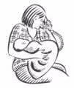











































Slide 6
TIPS: Collective vision and objectives
Consider other international/national alliance visions to maximise collective influence
Describe from women’s/families perspective rather than services
Be ambitious; think long term; make it inspirational
Stick to the core all current and future members would agree to, and (targets could not disagree with!)
Where possible use existing guidelines/standards for more detailed definitions at a later stage; where they don’t exist, get members to start creating them

Slide 7
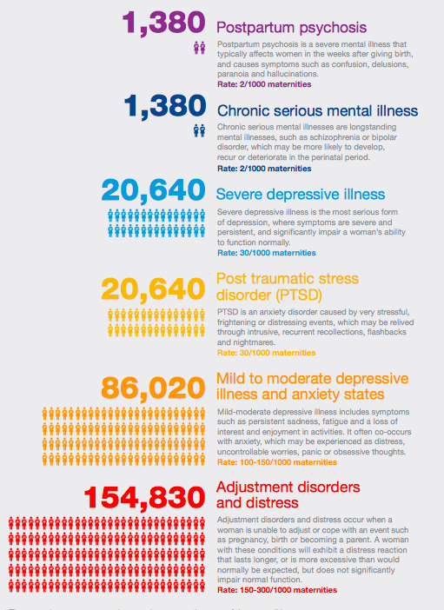
UK MMHA Vision
All women across the UK have consistent, accessible, high quality care and support for their mental health during pregnancy and postnatally.

Slide 8
Perinatal mental health for all
The system ensures:
Knowledge, understanding, compassion: all professionals are trained in perinatal MH and trauma informed compassionate healthcare
Continuity of carers
Coordination and communication between services and individuals
Care that empowers women
Encouragement of partner and family support, and peer support networks
Access to more specialist knowledge, expertise and advice for professionals across the system and, if necessary, for women and babies

Slide 9
Good perinatal mental health care
Detection and care in primary care, maternity, and universal children’s services
Prediction, prevention, detection, treatment
Training for all staff
Coordination and communication between all staff and services
Specialist perinatal care including preconceptual, antenatal, postnatal to 2 years
National action on awareness, stigma and domestic violence

Slide 10
Good Care: Simplified Perinatal MH Pathway
Routine antenatal care
History of mental illness and current mental health assessed at first contact and booking
Mental health care
Maternity services
Perinatal MH
services
History of possible severe mental illness or current severe illness, identified by any service
Specialised
perinatal
care pathways:
Bipolar disorder
Schizophrenia
Complex PTSD
Depression
Anxiety
OCD
Any positive responses to questions (communicate for information)
Communicate for information
Talking therapies
Other agencies
GP, primary care, IAPT
Support from GP, HV and MW, plan continued close monitoring in the early postnatal period. Obtain specialist advice as necessary.
Perinatal triage and assessment process
Perinatal telephone advisory service to professionals
Support from GP, HV and MW
Perinatal specialist inpatient care (mother and baby unit)
3rd sector
Q
If persists or worsens
Coping with daily living problems
Current mild illness
Routine postnatal care
GP assessment for medication and talking therapies & continued support from GP, HV and MW
NB! At every stage assess and enhance mother-infant relationship
Current moderate illness
If persists or worsens
Current severe illness
General adult MH services
Society: nurture families, fight ignorance, build resilience

Slide 11
Why did we start with specialised perinatal MH care in the UK?
STRATEGY: This is the area that has the greatest influence on developments across the whole APMH pathway.
OPPORTUNITY: High level of support in the NHS and in policy and guidance
URGENCY: High level of both opportunity and risk
IMPACT: Relatively small investment would lead to early visible gains
FEASABILITY: Well tested models supported by evidence, guidance and policy

Slide 12
2. Build the foundations for successful influence
Members collective commitment to agreed and understood vision and objectives
Members commitments for actions to contribute to these, coordinated with other members
Collect and enhance evidence:
  Challenges and solutions
  Science and stories
  Verbal and visual
  Collective ‘quick messages’/soundbites
  Nurture great communicators and opinion leaders: professional and lived experience
  Website

Slide 13
Why perinatal MH?
Clear evidence of individual & family needs
Clear evidence of economic & social impact
Clear evidence of investment for health, public purse and society
Clear and consistent and scientific evidence and guidelines
Successful models for delivery of care
Quality standards & assurance
Active and consistent support from all stakeholders

Slide 14
TIPS: persuasive evidence
Select geographically/economically relevant research/data
Select intellectually and emotionally persuasive material
Present in a clear visual format that emphasises the key points
Select a material relevant to a range of perspectives
Always combine with real life stories/human/emotive content
Always combine problems with solutions

Slide 15
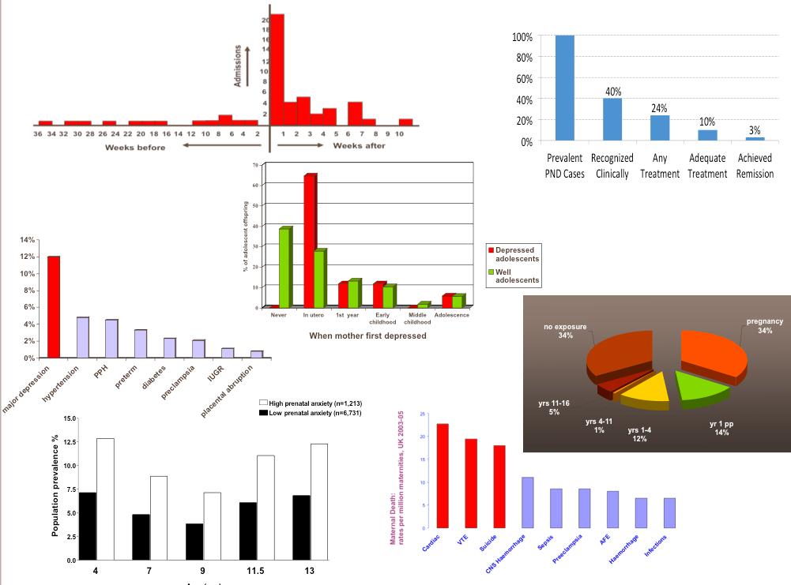
The highest risk of psychosis in the human lifespan
Unnacceptable quality of care
The strongest predictor of depression in adolescents
Depression: the most common major health complication of maternity
The highest risk time for depression in mothers
Double the risk of child emotional and behavioural problems
A principal cause of maternal mortality

Slide 16



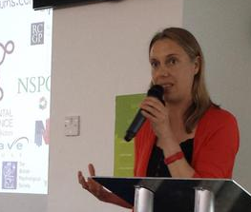

Lived experience and real life stories
More than 1 in 10 women develop a mental illness during pregnancy or the first year after having a baby
7 in 10 women hide or underplay the severity of their illness

Slide 17
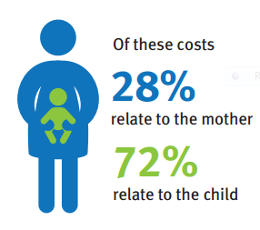
Economic costs (UK) (LSE, 2014)
Cost if we don’t act £8.1bn£337m
Cost of taking action

Slide 18
Parity is cheap!
Eg. UK costs
Specialist maternity (physical) care = £2800/birth
Specialist maternity negligence costs £690/birth
Specialist perinatal mental health care = £160/birth
Whole Perinatal MH pathway £407/birth
Costs if we stay as we are = £8.1bn

Slide 19

National quality standards and patient feedback

Slide 20
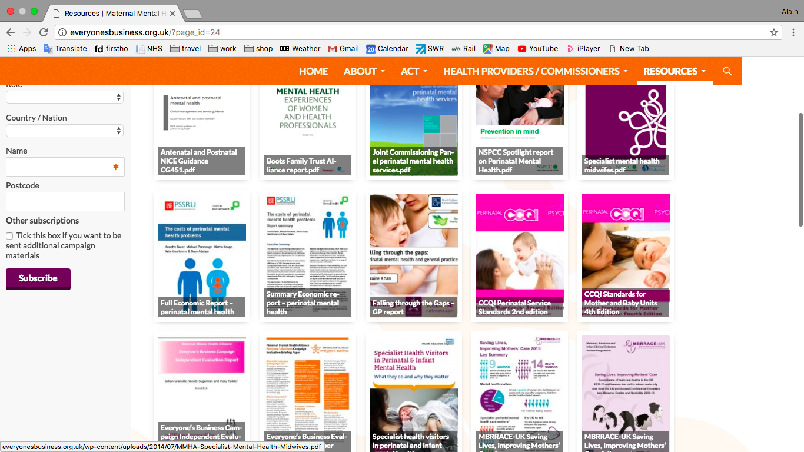
UK: Tons of guidelines and policies and all in agreement!

Slide 21





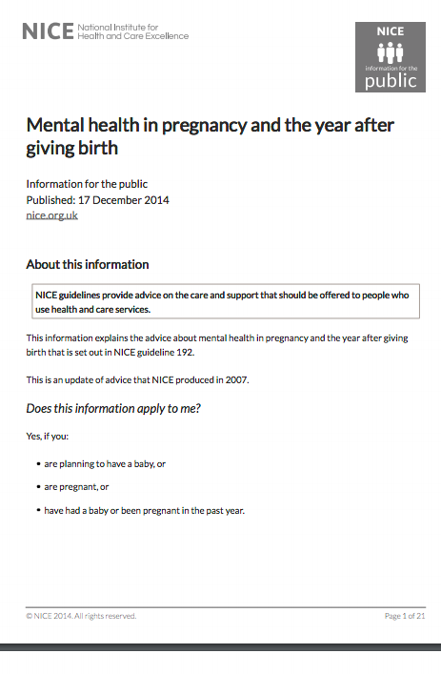

Global policy and guidance

Slide 22
3. Make change happen
The most effective agent of change is the action of Members (=organisations)
Unleash their creativity and impact through encouragement, big requests, recognition
Encourage coordination and collaboration between members through regular sharing and connection

Slide 23
TIPS: engaging members
Avoid charging a membership fee: joining and contributing to collective activity much more important than money; also easier to say:
‘ask not what the Alliance can do for you but ask what you can do for the Alliance (and its vision)’
Get members to communicate their planned actions with each other (for coordination, encouragement and peer pressure!)
Don’t hesitate to make big asks of members

Slide 24
TIPS: engaging targets
Get ready with the above before making approaches
But also don’t miss golden opportunities
Tailor form and content to the target: think of the targets perspective
Use members for ‘backroom’ and ‘corridor’ influencing before and after any contact
Use peer pressure: eg. negotiate a roundtable under the aegis of a senior politician/minister (costs them nothing) and invite key leaders
Offer solutions, incl. costings, timescales, quality assurance…

Slide 25

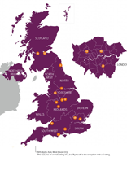
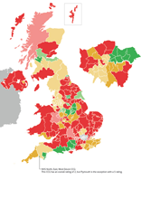


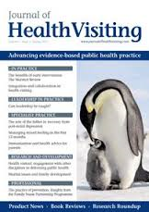





Lessons from MMHA UK: what worked
Clear evidence of unmet need
££ for a campaign
Lived experience at the core
Alliance and logo
Creating peer pressure amongst key targets
Media support
Economic evidence
Publications, reports and scientific data

Slide 26
Perinatal MH will adapt to any political priority/zeitgeist….eg. if it’s integration:
Integration beyond your wildest dreams:
primary and secondary
physical and mental
acute and chronic
peer support and professional care
medical and psycho-social
world leading good practice and innovation
Try it with parity, equity, early years, mental health, women’s health, maternity, reproductive health, suicide, human capital, happiness, productivity, health care, protection of children, etc, etc, …

Slide 27


Slide 28


Slide 29
GAMMH next steps 2020
Engage more international organisations and open membership to national alliances
Encourage, inform and support the development of national and regional MMHAs: eg. African, Francophone, Hispanic, Nordic,…
Develop campaigning tools: key evidence; personal experiences; maps; economic report

Slide 30
“Vision without Action is merely a dream. Action without Vision is merely passing time. Vision with Action can change the world.”
Nelson Mandela

